Slide 1
Confluent Rest Proxy
Shankar Sri Baabu M

Slide 2
Need For Rest Proxy
Sometimes the Producer / Consumer may be Non – Java.
Ex: PHP, R etc.
In these scenarios , All the languages probably will have Rest Client / Http Methods to send Http Requests.
With that kafka Can be easily Accessed.

Slide 3
Advantages
Easy to Consume RESTFul Endpoints.
Provides almost all Access Including the Schema Registry

Slide 4
Disadvantages of Rest Proxy
Kafka uses custom binary protocol (TCP Based) Which is faster.
Using REST Proxy over HTTP is slower than Kafka’s Built in Protocol.
Performance dips as high as 3-4 times in terms of throughput.

Slide 5
Types of Data allowed for Production/Consumption
JSON
Avro
Binary - Base64 Encoded

Slide 6
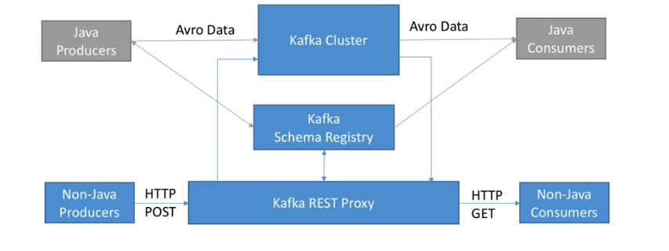
Rest Proxy’s Fit in Kafka Architecture

